Slide 2
Create a home page
Refer to /Django Features and Libraries/week1/cookie_assignment.ppt

Slide 3
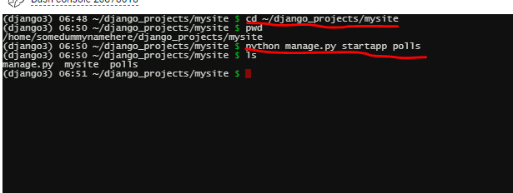
Make dummy1 application
cd ~/django_projects/mysite
workon django3
python manage.py startapp dummy1
Notes:
It will create a new polls folder(bunch of sub directory under polls folder) under mysite directory

Slide 4
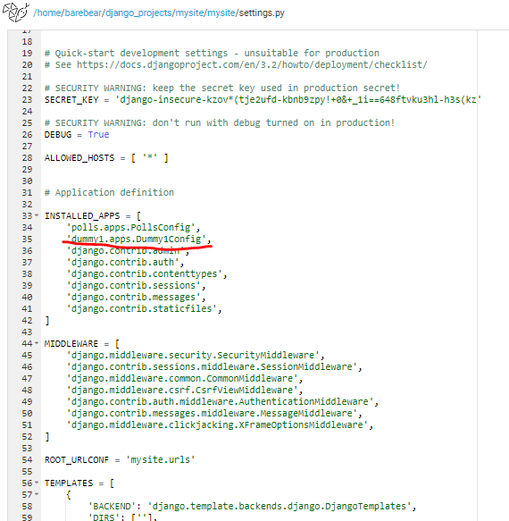
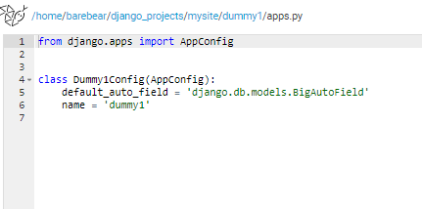
Update in settings.py

Slide 5
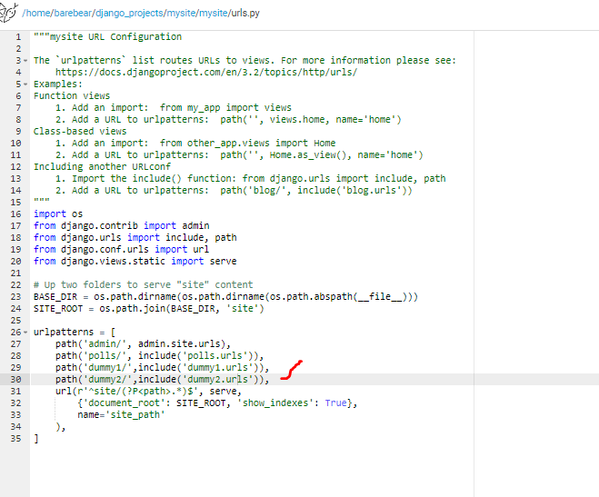
Update mysite/mysite/urls.py

Slide 6
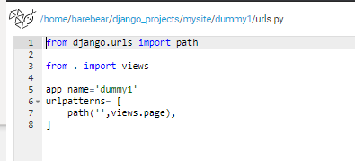
Create urls.py (dummy1/urls.py)

Slide 7
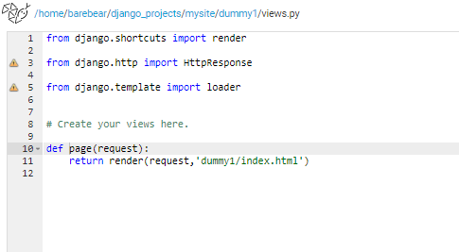
Update dummy1/views.py

Slide 8
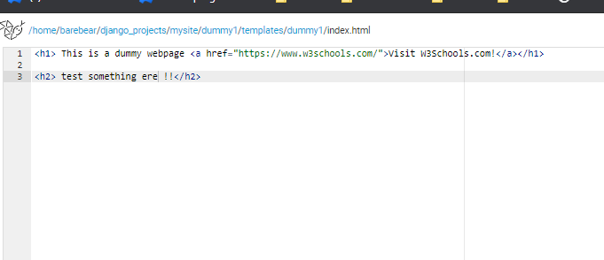
Create templates and html file

Slide 9
Upload and display imate
Refer to html_css_javascript/week3/week_buttonWithDivs.ppt

